Slide 1
Hacker Techniques, Tools, and Incident Handling
Chapter 2
TCP/IP Review

Slide 2
Learning Objective
Identify fundamental TCP/IP concepts and technologies related to networking.

Slide 3
Key Concepts
The OSI Reference Model and the TCP/IP model
Common TCP/IP protocols and how they are used
Common TCP/IP attacks

Slide 4
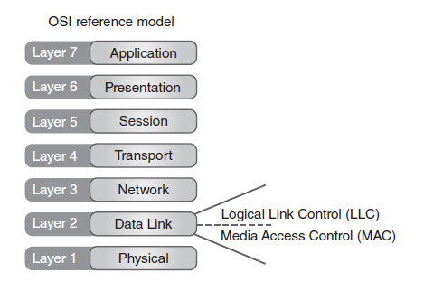
OSI Reference Model
Notes:
The OSI Reference Model is used mainly in today’s networking environment as both a reference model and an effective means of teaching distributed communication.
OSI functions in a predictable and structured fashion designed to ensure compatibility and reliability. The OSI Reference Model is made up of seven complementary but distinctly different layers, each tasked with carrying out a discrete group of operations.
Layers (from the top down): Application, Presentation, Session, Transport, Network, Data Link, and Physical
These layers are also referred to by number (7 is the Application Layer, and 1 is the Physical Layer.)
The OSI Reference Model is also implemented in two areas: hardware and software. The bottom two layers are implemented in hardware, and the top five are implemented through software.

Slide 5
The Role of Protocols
Set of agreed-upon rules through which communication takes place
Enable dissimilar systems to communicate quickly, easily, efficiently

Slide 6
Layer 1: Physical Layer
Transmits info to and from systems
Reveals how much and how long information is sent
Does not reveal of understanding of info being transmitted

Slide 7
Layer 1: Physical Layer (Cont.)
Physical Layer characteristics
Voltage levels
Data rates
Maximum transmission distances
Timing of voltage changes
Physical connectors and adaptors
Topology or physical layout of the network

Slide 8
Layer 2: Data Link Layer
Frame
IEEE 802.3
Flow control
ARP
Notes:
Frame — In networking, a container into which data is placed for transmission and delivery
IEEE 802.3 — Standard for Ethernet
Flow control — The mechanism that manages data flow between network nodes, to ensure that what is being sent does not exceed the capabilities of a given physical connection
ARP — Protocol responsible for translating IPv4 addresses to a previously unknown MAC address

Slide 9
Layer 3: Network Layer
Handles logical addressing and routing of traffic
IP addresses represent logical addresses
Nonpersistent addresses assigned via software that are changed as needed by the network
Used to route traffic
Assist in the division of a network into logical segments
Important to understand how attackers can manipulate data at this layer and how to implement security controls to stop them

Slide 10
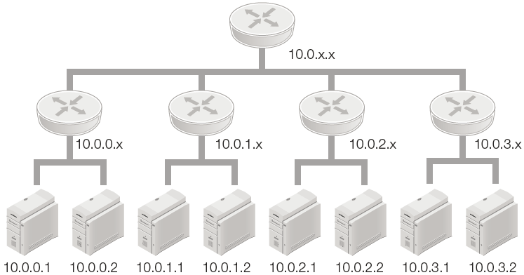
Layer 3: Network Layer (Cont.)

Slide 11
Layer 4: Transport Layer
Ensures data is completely and correctly sent
Users error recover and flow control
Similar to Data Link Layer
Guarantees link between stations and delivery of data
Responsible for communicating between host computers
Verifies sender and receive are ready to initiate data transfer

Slide 12
Layer 4: Transport Layer (Cont.)
Transmission Control Protocol (TCP)
Connection oriented
User Datagram Protocol (UDP)
Connectionless
Provides reliable communication through the use of handshaking, acknowledgments, error detection, and session teardown
Offers speed and low overhead as its primary advantages

Slide 13
Layer 5: Session Layer
Connections
Creation
Termination
Management
Notes:
Session Layer (Layer 5)
Is responsible for the creation, termination, and management of a given connection
When a connection is required between two points using TCP, Session Layer makes sure creation and destruction of the connection occur properly

Slide 14
Layer 5: Session Layer (Cont.)
RPC
Remote Procedure Call
SSH
Secure Shell
NFS
Network File System
Notes:
The Session Layer Includes protocols such as Remote Procedure Call (RPC), Secure Shell (SSH), and Network File System (NFS).

Slide 15
Layer 6: Presentation Layer
Data converted for programs at Application Layer
Gateway services – send and receive data between different networks that use different protocols
Encryption and decryption services
Encryption provides ability to keep information confidential and verify integrity of information

Slide 16
Layer 7: Application Layer
Supports several services used by application software and other services
Is the point at which application software accesses network services
Think of application software as a microwave oven and the Application Layer as the electrical outlet that the microwave plugs into to get power

Slide 17
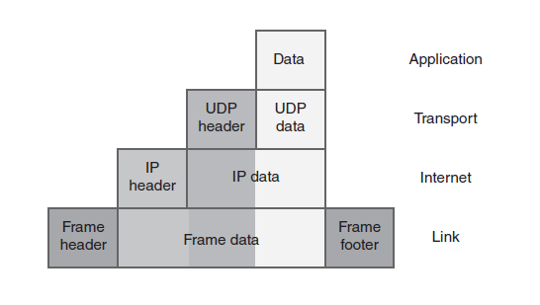
Layer 7: Application Layer

Slide 18
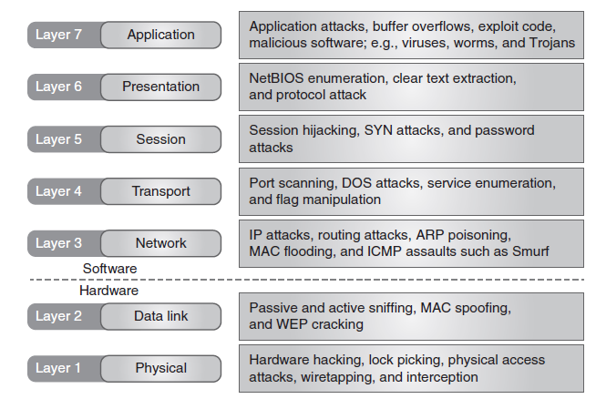
Mapping the OSI Model to Functions and Protocols

Slide 19
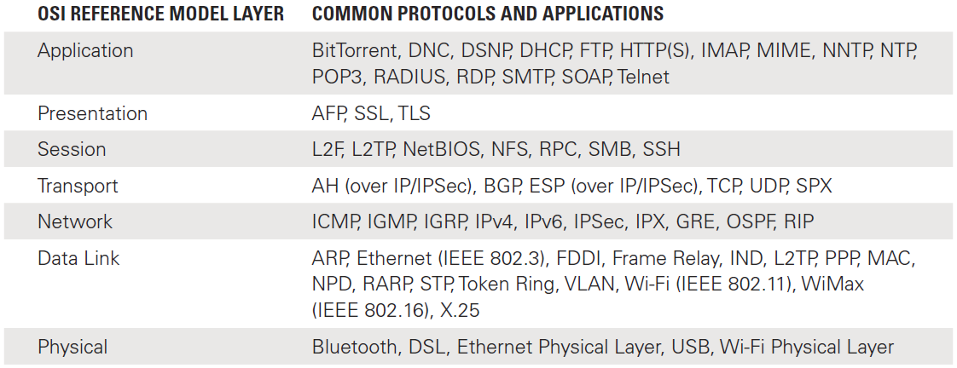
Mapping the OSI Model to Functions and Protocols (Cont.)

Slide 20
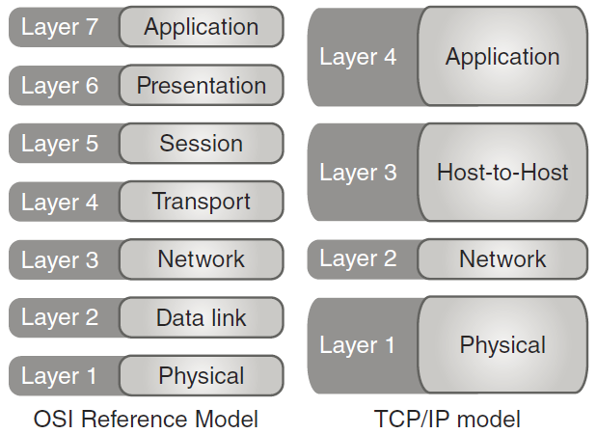
TCP/IP: A Layer-by-Layer Review

Slide 21
TCP/IP Model
An alternative to the OSI model
Defines four layers
Four layers of the TCP/IP model
Network
Physical
Host-to-Host
Application

Slide 22
Physical or Network Access Layer
Equipment
Repeaters
Hubs
Bridges
Switches

Slide 23
Physical or Network Access Layer Protocols
Common physical or network access layer protocols
Address Resolution Protocol (ARP)
Reverse Address Resolution Protocol (RARP)
Neighbor Discovery Protocol (NDP)
Inverse Neighbor Discovery (IND)
Transport Layer Security (TLS)
Layer 2 Tunneling Protocol (L2TP)
Point-to-Point Protocol (PPP)
Serial Line Interface Protocol (SLIP)

Slide 24
Physical or Network Access Layer Protocols
Spoofing MAC addresses
Poisoning MAC address resolution
Wiretapping
Interception
Eavesdropping

Slide 25
Physical or Network Access Layer Controls
Countermeasures to protect against Physical or Network Access Layer attacks:
Fiber optic cable
Wired Equivalent Privacy (WEP)
Wi-Fi Protected Access (WPA)
Wi-Fi Protected Access 2 (WPA2)
Point-to-Point Tunneling Protocol (PPTP)
Challenge Handshake Authentication Protocol (CHAP)
Notes:
WEP use not recommended

Slide 26
Network or Internet Layer
Routers
Do not forward broadcast packets
Forward multicast packets
Have highest latency
Have most flexibility
Forwarding decisions based on destination IP address
Require configuration
Notes:
The router is the primary piece of equipment at the Network or Internet Layer.
Routers direct traffic at lower layers using logical addresses as opposed to using physical addresses as are used by switches.
Routers move traffic between different networks allowing paths to form to direct traffic between multiple networks.

Slide 27
Network or Internet Layer Routing Protocols
Routing Information Protocol (RIP)
Open Shortest Path First (OSPF)
Intermediate System to Intermediate System (IS-IS)
Enhanced Interior Gateway Routing Protocol (EIGRP)
Border Gateway Protocol (BGP)
Notes:
Routing protocols determine the best path to send traffic at a point in time.
RIP-A distance-vector routing protocol
OSPF-The most common link-state routing protocol
IS-IS-A link-state Interior Gateway Protocol (IGP) for the Internet, used to distribute IP routing information throughout a single Autonomous System (AS) in an IP network
EIGRP-A dynamic routing protocol
BGP-A dynamic routing protocol; is the routing protocol of the Internet

Slide 28
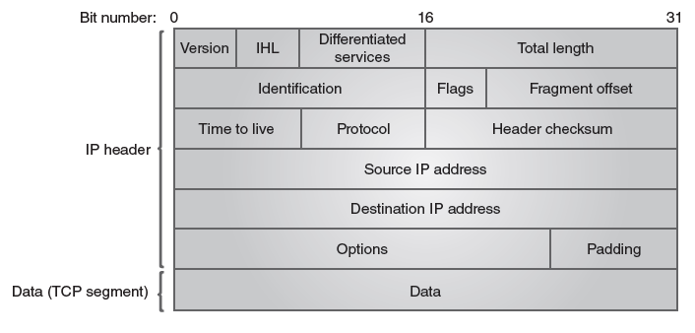
Network or Internet Layer Routing Protocols (Cont.)
IPV4 Header
Notes:
To ensure traffic reaches its intended destination, routers examine packet headers to determine the target address.
When receiving a packet, a router examines the header of the packet with specific emphasis on the target address.
Once the target address is obtained, the router consults a routing table to determine where to send the information.

Slide 29
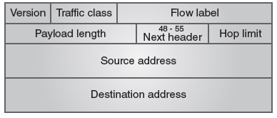
Network or Internet Layer Routing Protocols (Cont.)
IPv6 Header
Notes:
As with IPv4, the router will examine the IPv6 header to determine the target address and rout to the correct destination.

Slide 30
Network or Internet Layer Routing Protocols (Cont.)
OSPF advantages
Security
The use of IP multicasts to send out router updates
Unlimited hop count
Better support for load balancing
Fast convergence
Notes:
Link state calculates the best path to a target network by one or more metrics such as delay, speed, or bandwidth.
Once this path has been determined, the router will inform other routers what it has discovered.
Link-state routing is considered more flexible and robust than distance-vector routing protocols.
OSPF is the most common link-state routing protocol and is used as a replacement for RIP in most large-scale deployments.

Slide 31
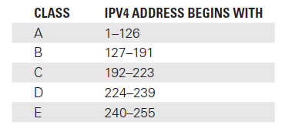
IPv4 Addresses
IPv4 address example: 192.168.1.199
Notes:
IPv4 addresses are four-byte (32-bit) numbers.
Addresses are in a four-decimal number format separated by decimal numbers.
Each decimal number is one bit long allowing numbers from 0 – 255.
Always look at the first octet to determine the IPv4 class.

Slide 32
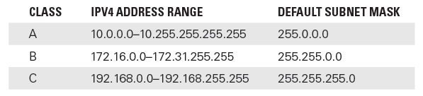
IPv4 Addresses (Cont.)
Nonroutable
Notes:
Some addresses (including their subnet masks) are reserved for private use and are nonroutable.
Traffic cannot be passed from private addresses onto the Internet.
Some home routers default to 192.168.0.1 or 192.168.1.1 making them nonroutable.

Slide 33
IPv6 Addresses
IPv6 address example: 2600:1700:131:1ba0:4894:d6fa:7e7e:75cf
IPV6 enhancements:
Subnetting support in the address format
Heirarchical addressing schemes
Simplified packet headers
Multicast allows for multiple destinations
Includes IP security
Notes:
IPv6 addresses are 128-bit numbers that can reference far more devices than was previously possible.
IPv6 uses a completely different notation from IPv4. Instead of the dot notation, IPv6 addresses are expressed as hexadecimal values, separated by colons into eight groups of 16 bits.

Slide 34
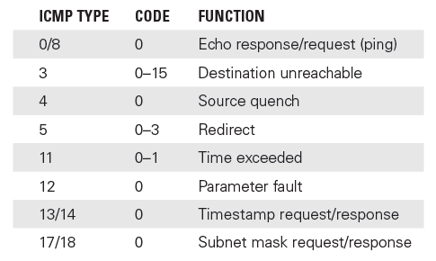
IPv6 Addresses (Cont.)
Internet Control Message Protocol (ICMP)
Notes:
The graphic above represents the eight most common ICMP types.
ICMP was originally designed as a network diagnostic and logical error reporting tool.
ICMP is essential for network management and provides error reporting and diagnostics.
There are two current versions of ICMP: ICMPv4 for IPv4 networks and ICMPv6 for IPv6 networks.
Pings are the most common ICMP tool used by network administrators, allowing them to determine if a host is up and running.

Slide 35
Network or Internet Layer Threats
Sniffers
Hardware- or software-based devices that view or record traffic flows over the network
Sensitive data can be viewed through a sniffer
Promiscuous mode allows a sniffer to capture any packet it can see
Wireshark is most widely used sniffer

Slide 36
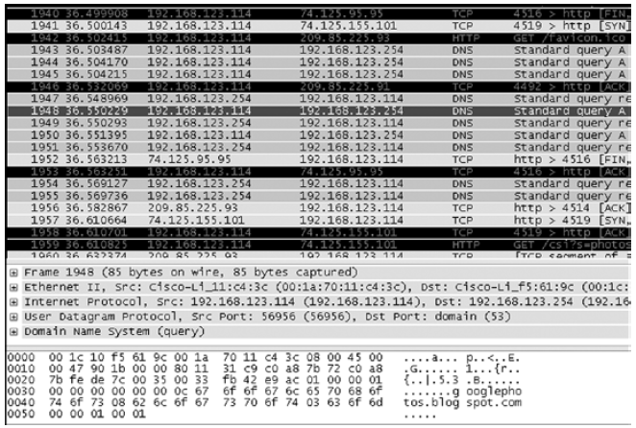
Network or Internet Layer Threats (Cont.)
Notes:
Wireshark is comprised of three displays or windows.
The first display shows packets which have been captured.
The middle figure shows a highlighted packet which needs review.
The bottom packet shows individual packet content.

Slide 37
Network or Internet Layer Controls
IPSec
Packet filters
NAT
Notes:
IPSec — Most widely used standard for protecting IP datagrams. It is integral to IPv6 and keeps data confidential during transit.
Packet filters — Must be configured through access control lists (ACLs). ACLs enable rules that allow or block traffic based on packet headers.
Network address translation (NAT) — Addresses a need for more IPv4 only addresses and is used to translate between public and private addresses.

Slide 38
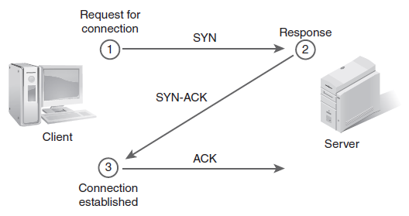
Host-to-Host Layer Protocols
TCP startup and shutdown

Slide 39
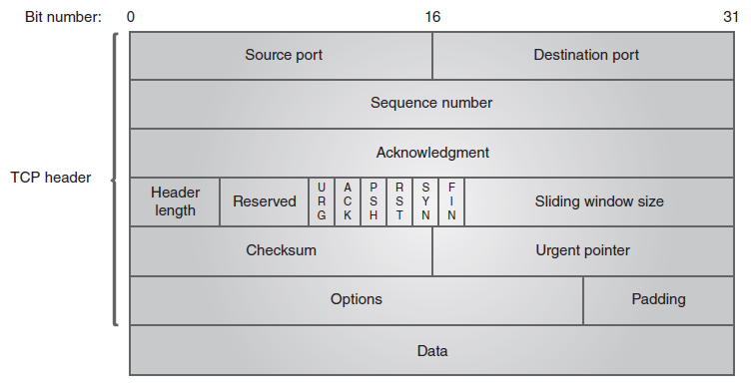
Host-to-Host Layer Protocols (Cont.)
TCP frame structure

Slide 40
Host-to-Host Layer Threats
Port scanning
Session hijacking
SYN attack
Notes:
Port scanning — A technique in which a message is sent to each port, one at a time. By examining the response, the attacker can determine weaknesses in the applications being probed and determine what to attack.
Session hijacking — A type of attack in which the attacker places himself between the victim and the server. The attack is made possible because authentication typically is done only at the start of a TCP session.
SYN attack — A SYN attack is a distributed denial of service (DDoS) attack in which the attacker sends a succession of SYN packets with a spoofed return address to a targeted destination IPv4/IPv6 device but does not send the last ACK packet to acknowledge and confirm receipt. Eventually, the target system runs out of open connections and cannot accept any legitimate new connection requests.

Slide 41
Host-to-Host Layer Controls
Secure Sockets Layer (SSL)
Transport Layer Security (TLS)
SOCKS
Secure Remote Procedure Call (S/RPC)
Notes:
Secure Sockets Layer (SSL) — SSL, an older security-oriented protocol, is considered application independent and can be used with Hypertext Transfer Protocol (HTTP), File Transfer Protocol (FTP), and Telnet to run on top of it transparently. SSL uses a public key cryptography system based on the RSA algorithm that is named after its authors, Rivest, Shamir, and Adleman.
Transport Layer Security (TLS) — TLS is an upgrade to SSL and is backward compatible, but they do not interoperate. TLS, much like SSL, is designed to be application independent.
SOCKS — This is another security protocol developed and established by Internet standard RFC 1928. It allows client/server applications to work when separated by one or more firewalls.
Secure RPC (S/RPC) — This adds a layer of security onto the RPC process by adding Data Encryption Standard (DES) encryption.

Slide 42
Application Layer
Application Layer services:
Domain Name System (DNS) converts fully qualified domain names (FQDNs) into numeric IP addresses; uses DNS uses TCP and UDP
File Transfer Protocol (FTP) moves files from one computer to another
Hypertext Transfer Protocol (HTTP) uses a request response protocol in which a client sends a request and a server sends a response; used across the Internet
Simple Network Management Protocol (SNMP) is a UDP service; offers encryption

Slide 43
Application Layer (Cont.)
Application Layer services:
Telnet is a TCP service; enables client at one site to establish a session with host at another site
Simple Mail Transfer Protocol (SMTP) is a TCP service; designed for exchange of electronic mail between networked systems
Trivial File Transfer Protocol (TFTP) transfers router configuration files and by cable companies to configure cable modems; requires no authentication

Slide 44
Application Layer Threats
Malware
Trojan horse
Denial of Service (DoS) attack
DDoS attack
Spyware
Virus
Worm
Ransomware
Botnets

Slide 45
Application Layer Controls
Malware scanners
Secure Shell (SSH)
Pretty Good Privacy (PGP)
Secure/Multipurpose Internet Mail Extension (S/MIME)

Slide 46
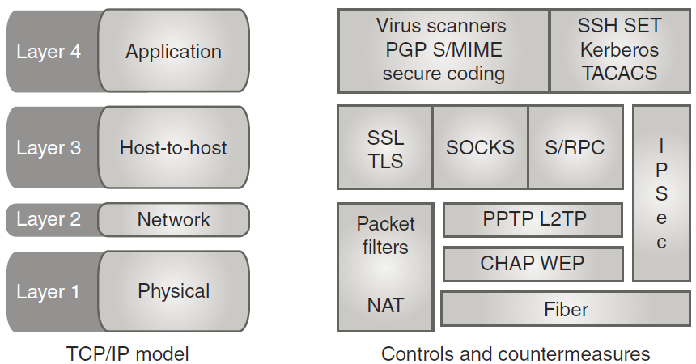
Application Layer Controls (Cont.)
TCP/IP model and each layer’s controls

Slide 47
Summary
The OSI Reference Model and the TCP/IP model
Common TCP/IP protocols and how they are used
Common TCP/IP attacks

